Slide 1
ALY6080 Integrated Experiential Learning
Group – 2
Prasanth Chimbili
John DiSessa
Tianyu Ouyang

Slide 2
Executive Summary
Dataset
Modifications & Cleaning
Tools
Python & Tableau
Exploratory Data Analysis
Analytics
Conclusions
Future Analysis

Slide 3
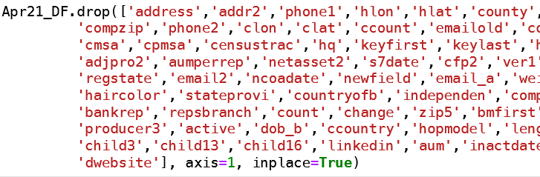
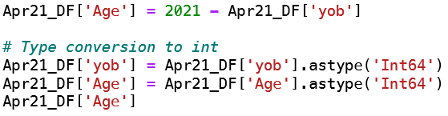
Dataset Modifications
Dropped over 50 columns
Removed Outliers
Removed Null Values
Manually Fixed Typos

Slide 4
Business Questions
How different certifications impact the income of the representatives?
Is there any correlation between hiring rate and stock performance or company's revenue?
Are there any gender biases?
Do certifications impact the income of representatives?

Slide 5
Exploratory Data Analysis
Representative Age
Gender
Incomes
Series Exams

Slide 6
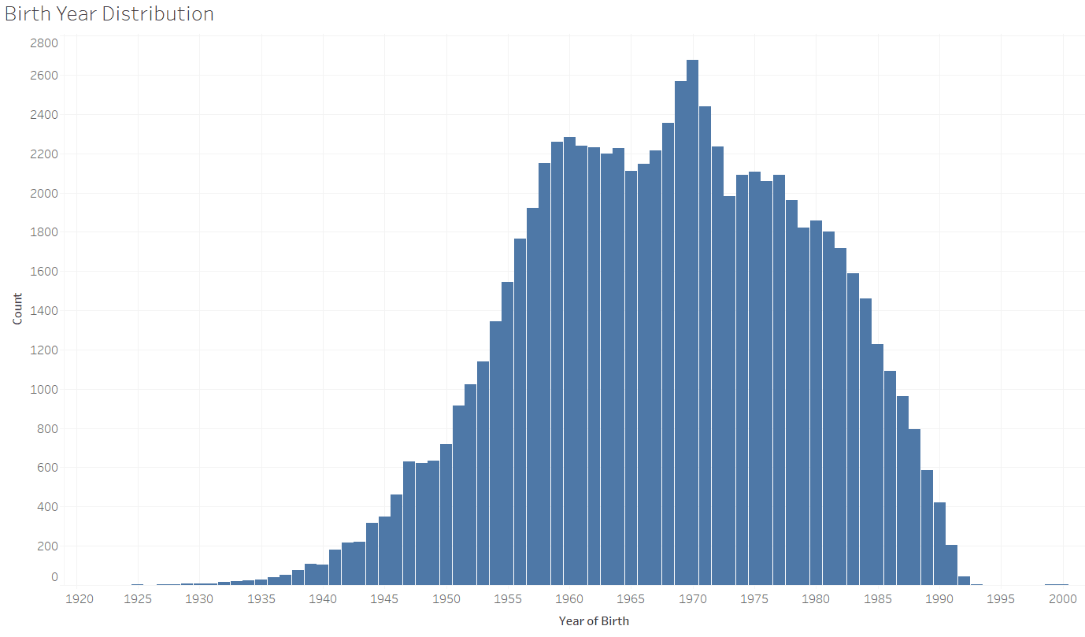
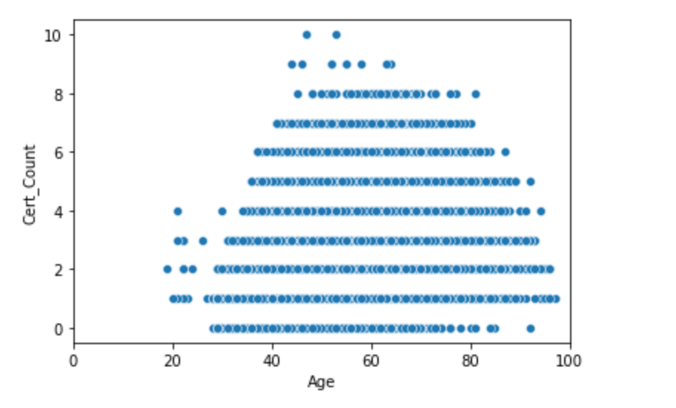
Age Distributions

Slide 7
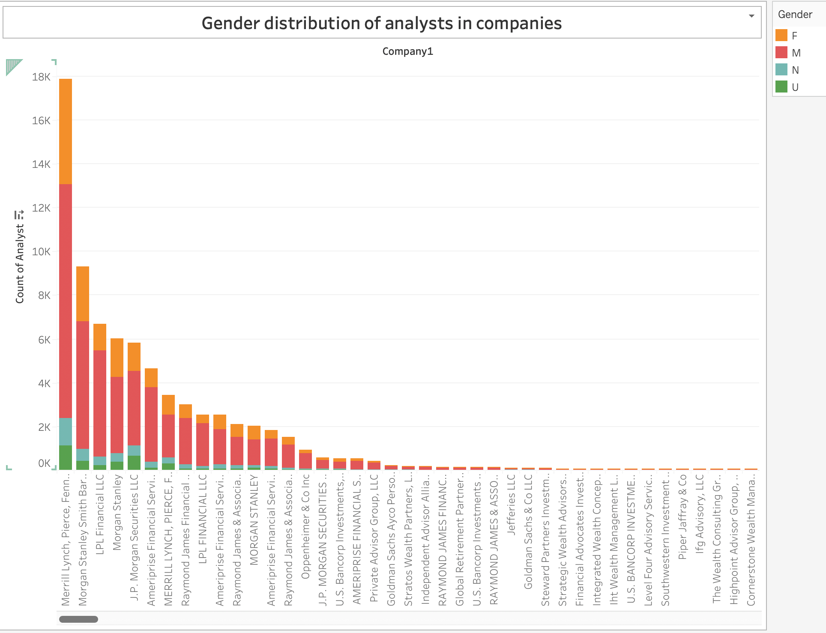
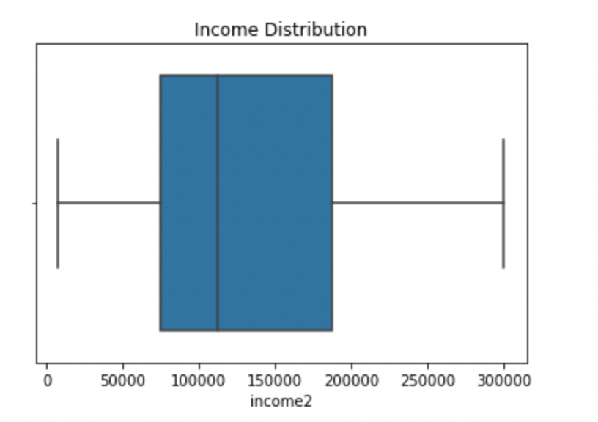
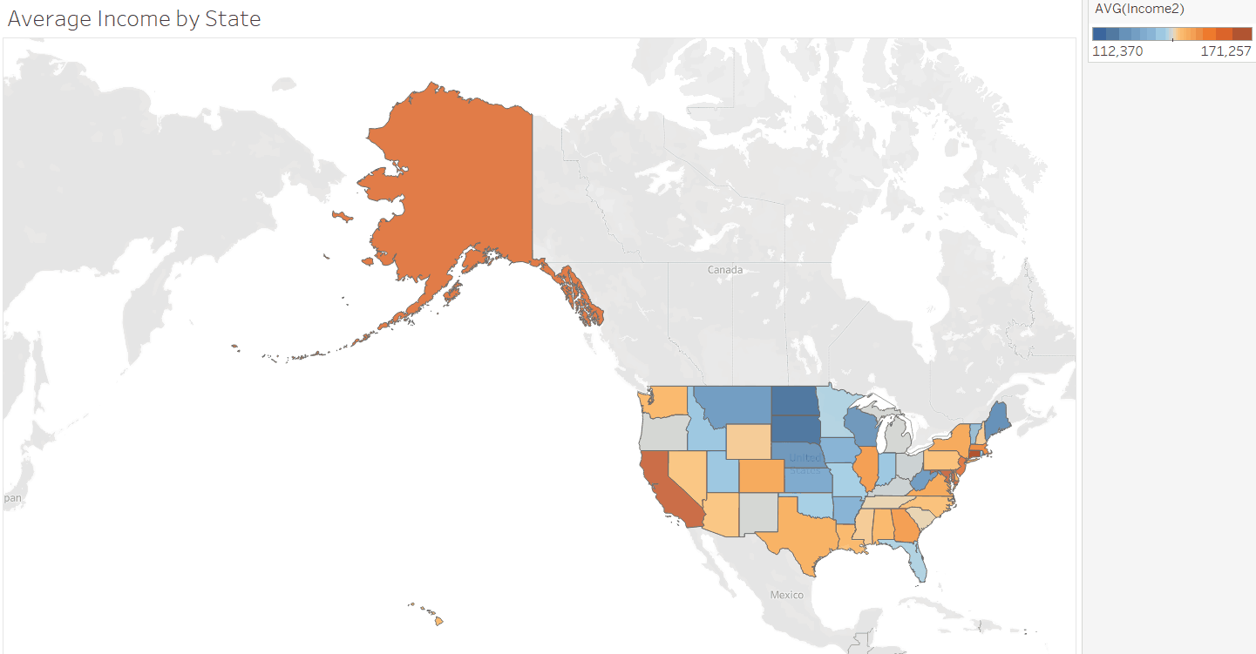
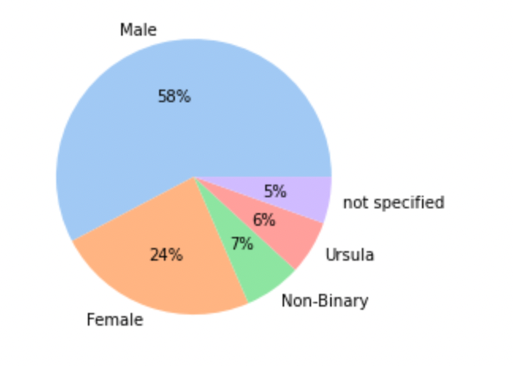
Gender & Income

Slide 8
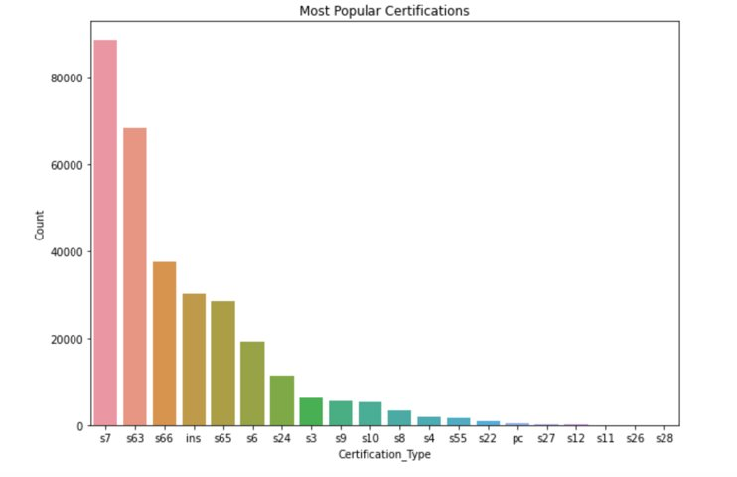
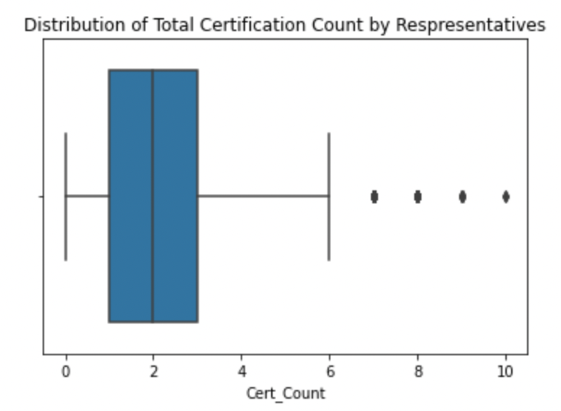
Series Exams

Slide 9
Analytics
Predictive Modeling
Series Exams
U4 Hits
Representative Hiring
Financial Performances

Slide 10
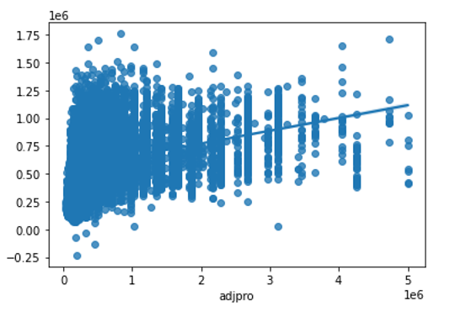
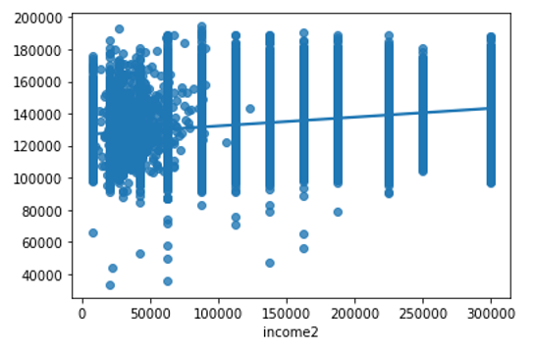
Predictive Modeling

Slide 11
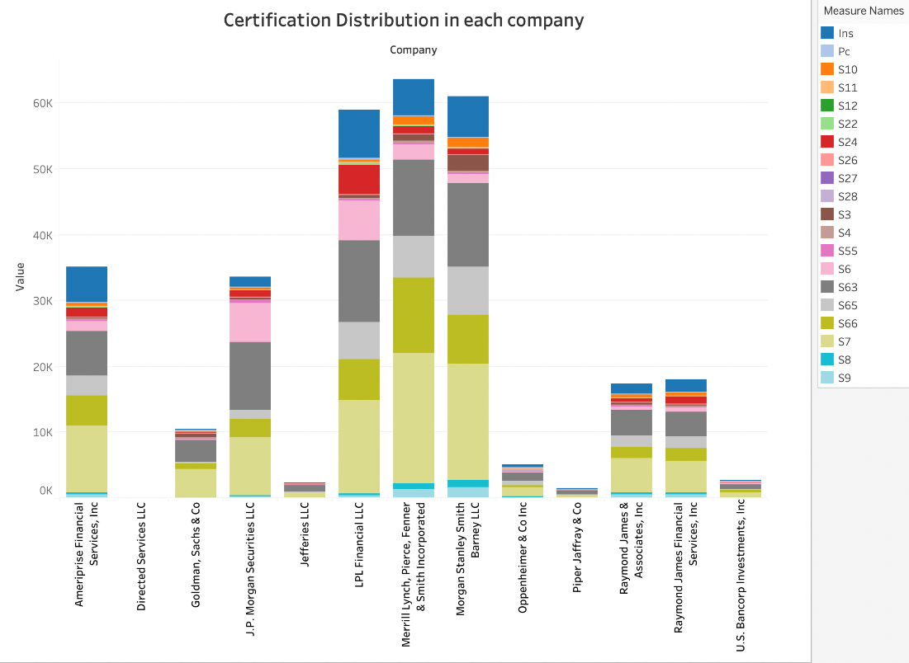
Series Exams

Slide 12
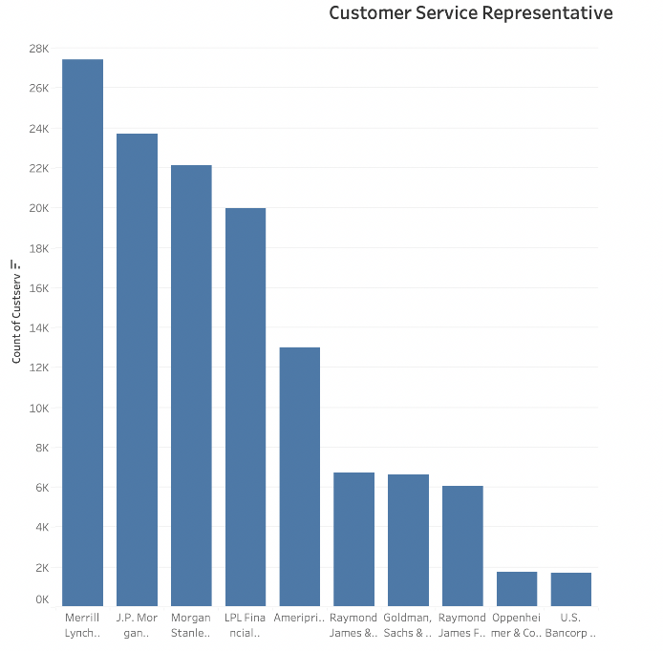
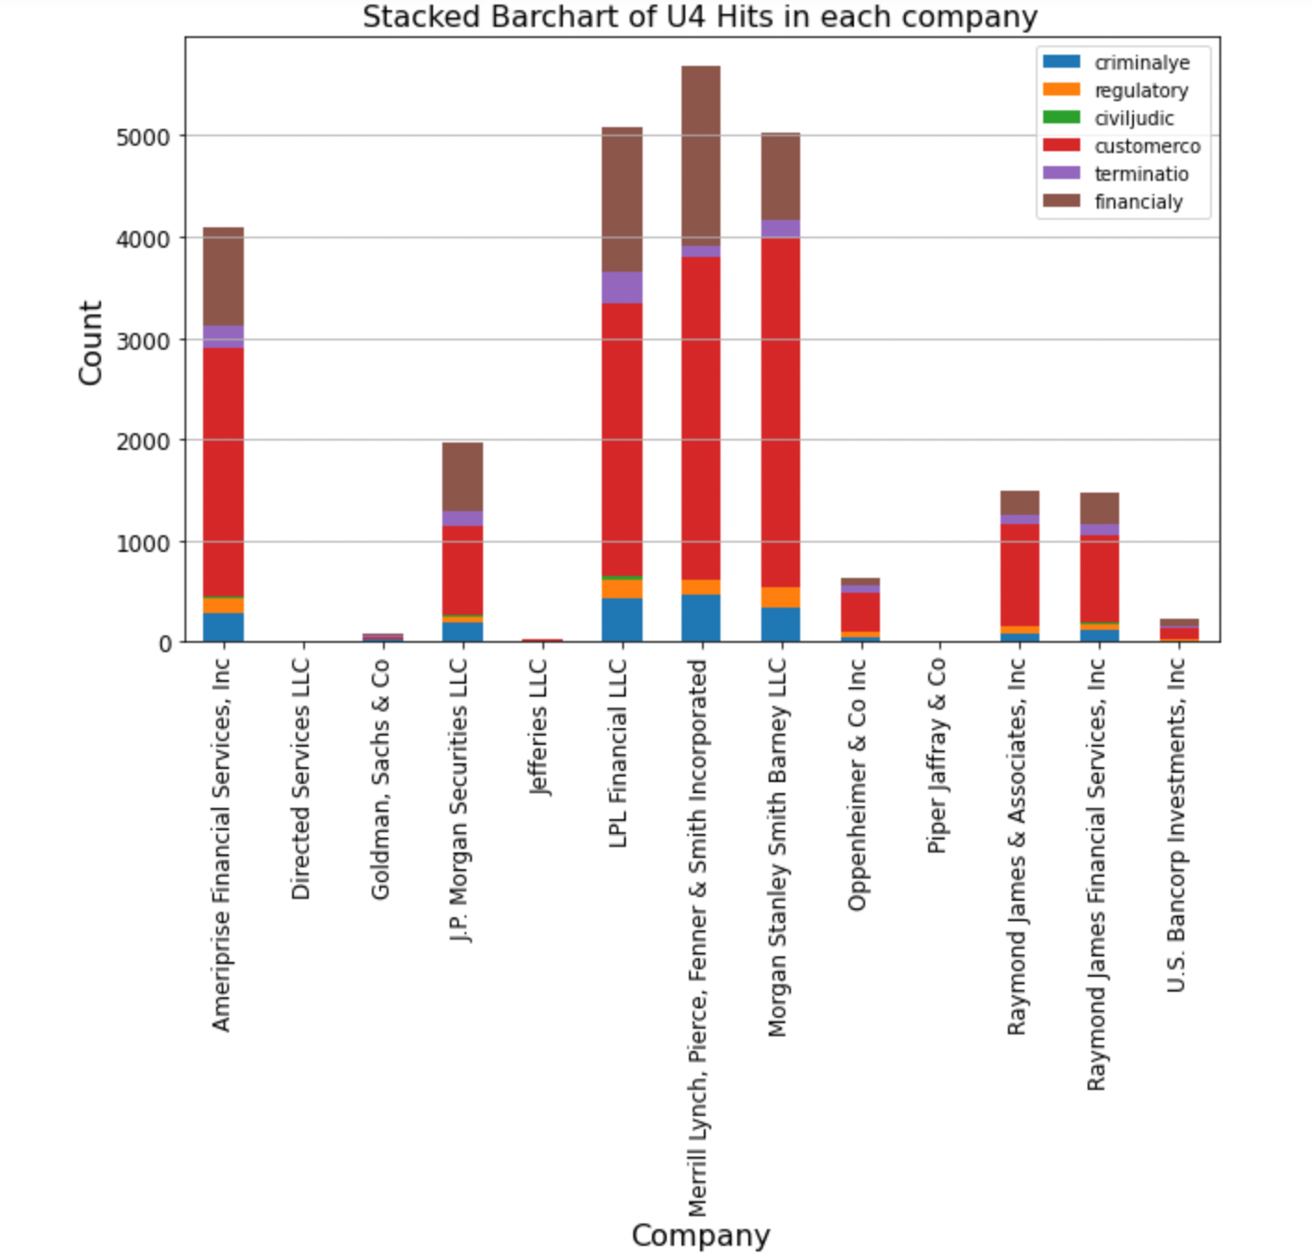
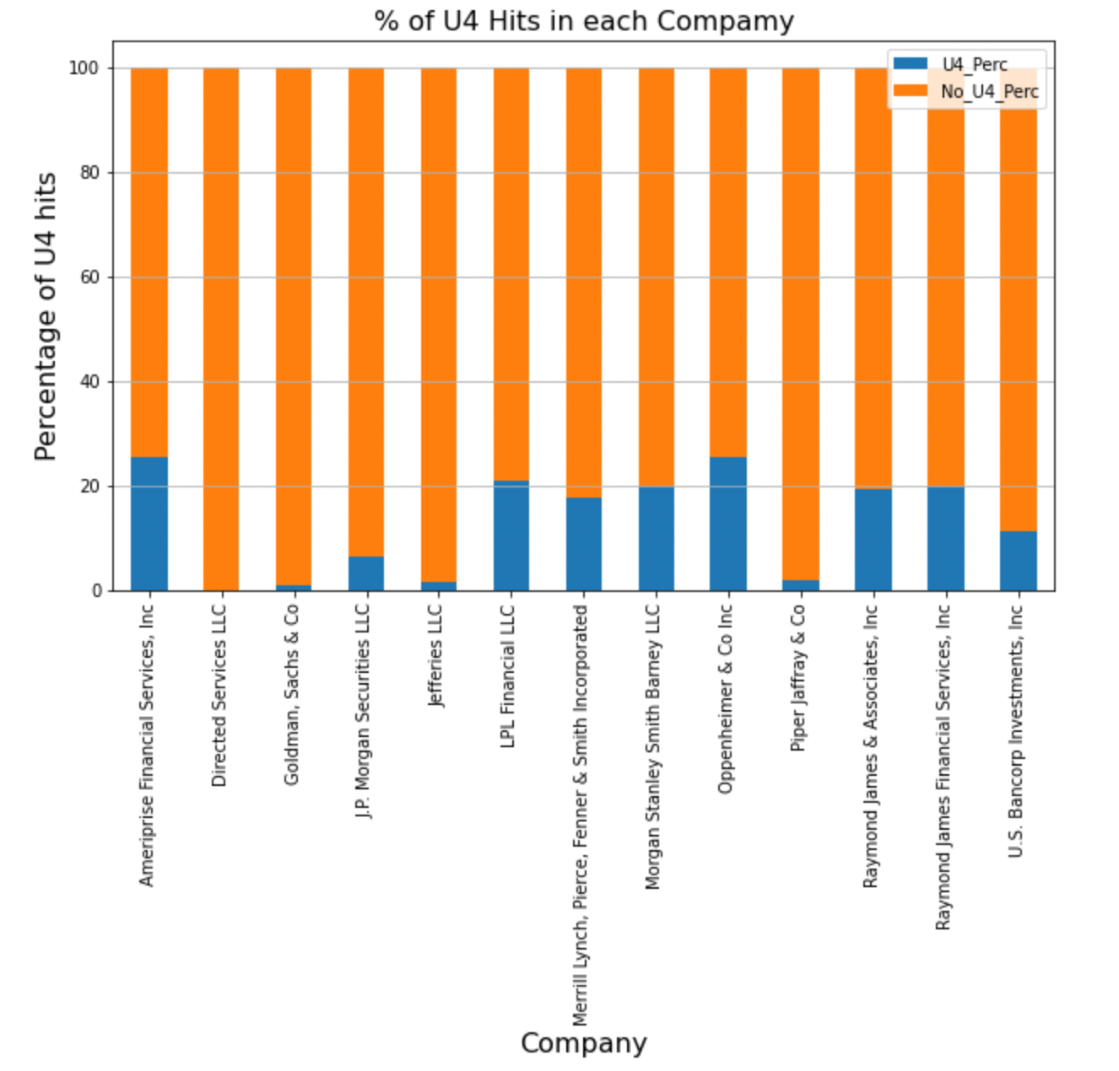
U4 Hits

Slide 13
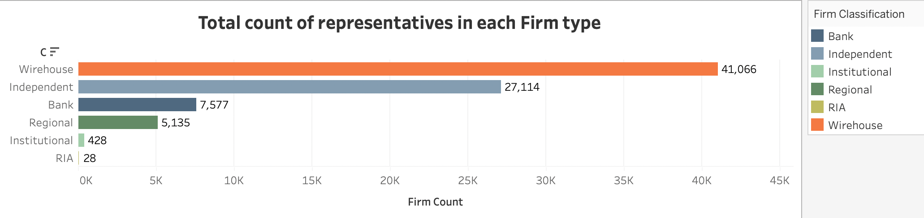
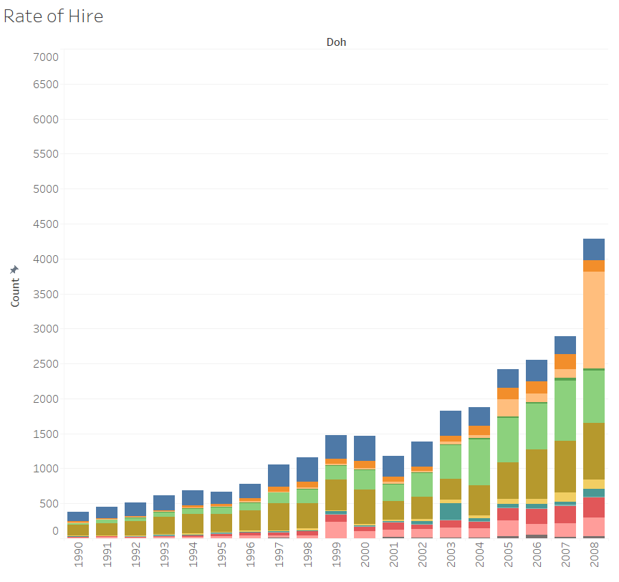
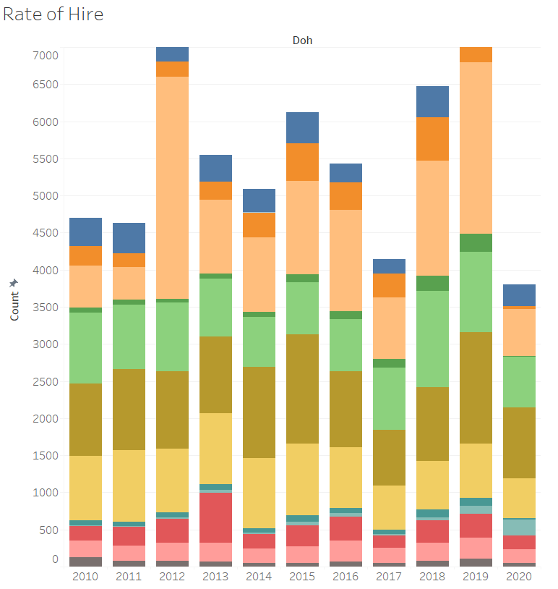
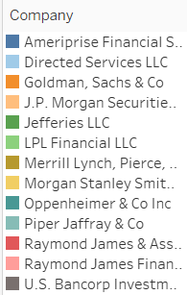
Representative Hiring

Slide 14
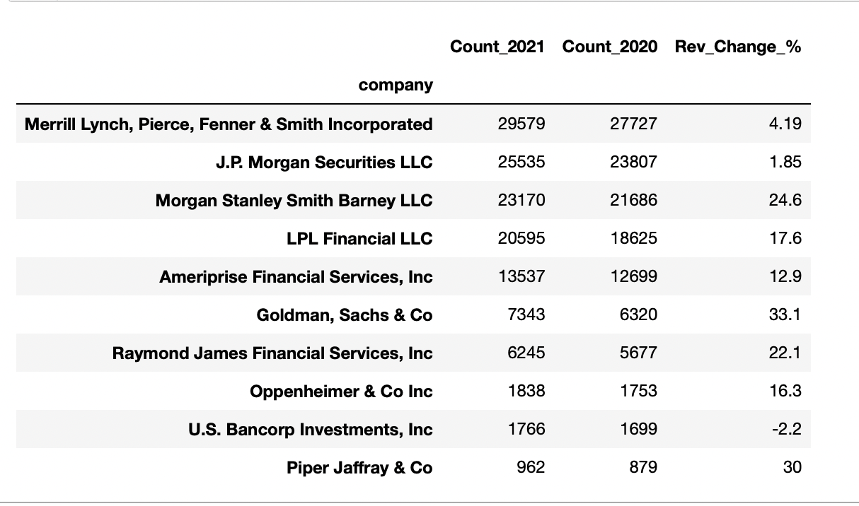
Financial Performance

Slide 15
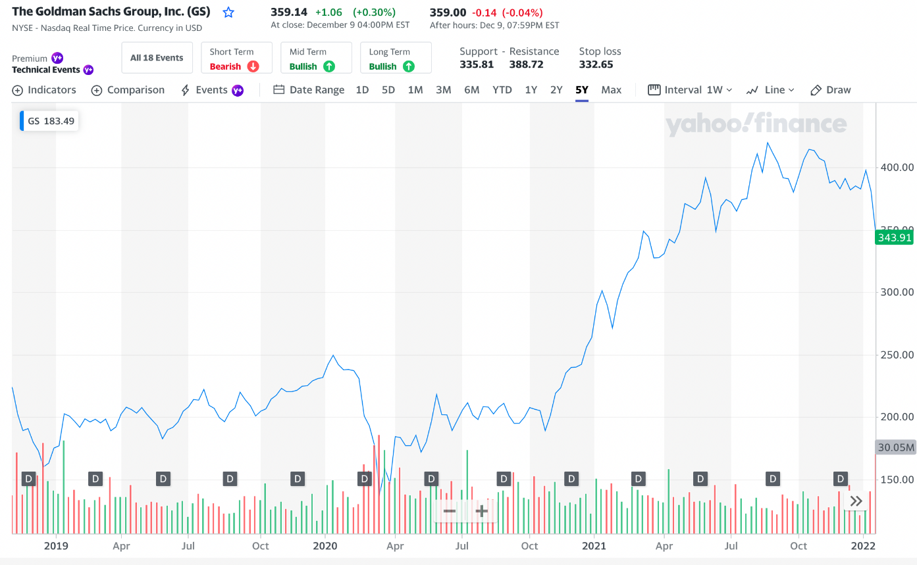
Financial Performance

Slide 16
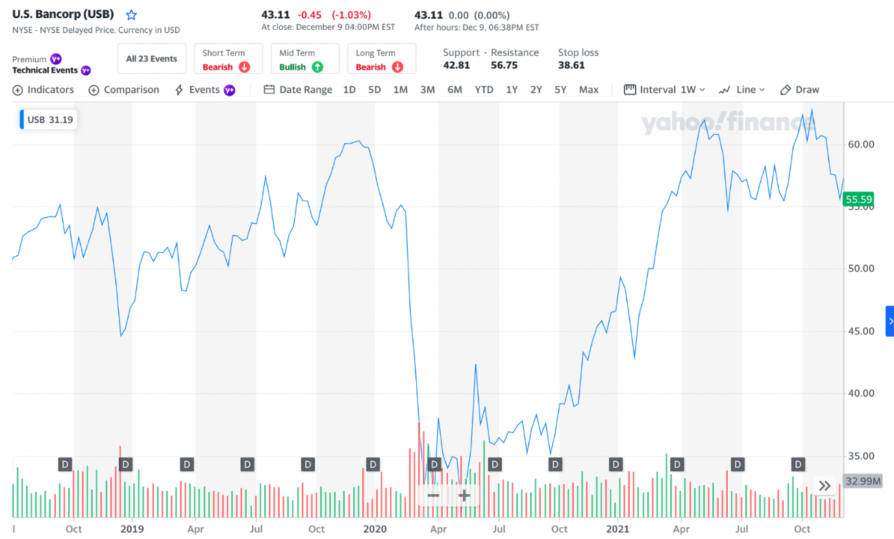
Financial Performance

Slide 17
Conclusions
Certifications & Ages
No effect on income
S66 Most Popular
Certificate Distributions Differ Between Companies
Small % of Industry Is Female
JP Morgan Hiring Different From Industry

Slide 18
Future Research
Advanced Financial Metrics
Leading or Lagging Indicators
Correlation Matrices

Slide 19
Questions?

